Slide 1

Image Encryption Tool
Name: Hammad Hussain
Role: Cybersecurity Intern
Organization: Prodigy InfoTech

Slide 2

Task-02: Pixel Manipulation for Image Encryption
This report details the design and implementation of an image encryption tool developed during an internship at Prodigy InfoTech.
Educational Focus
Pixel Manipulation
Focuses on reversible image transformations for learning purposes.
Utilizes pixel-level changes for encryption and decryption.

Slide 3
Task Objectives
1
Design & Implement
Create an image encryption and decryption tool.
2
Apply Pixel Manipulation
Use basic mathematical operations on pixels.
3
Ensure Reversibility
Utilize a consistent numeric key for both processes.
4
Command-Line Tool
Present the solution as a command-line interface.
5
Professional Documentation
Document the implementation clearly and professionally.

Slide 4

Scope & Assumptions
Educational and demonstration purposes only.
No real-world cryptographic security provided.
Input images are standard RGB (PNG/JPG).
Same numeric key for encryption and decryption.

Slide 5
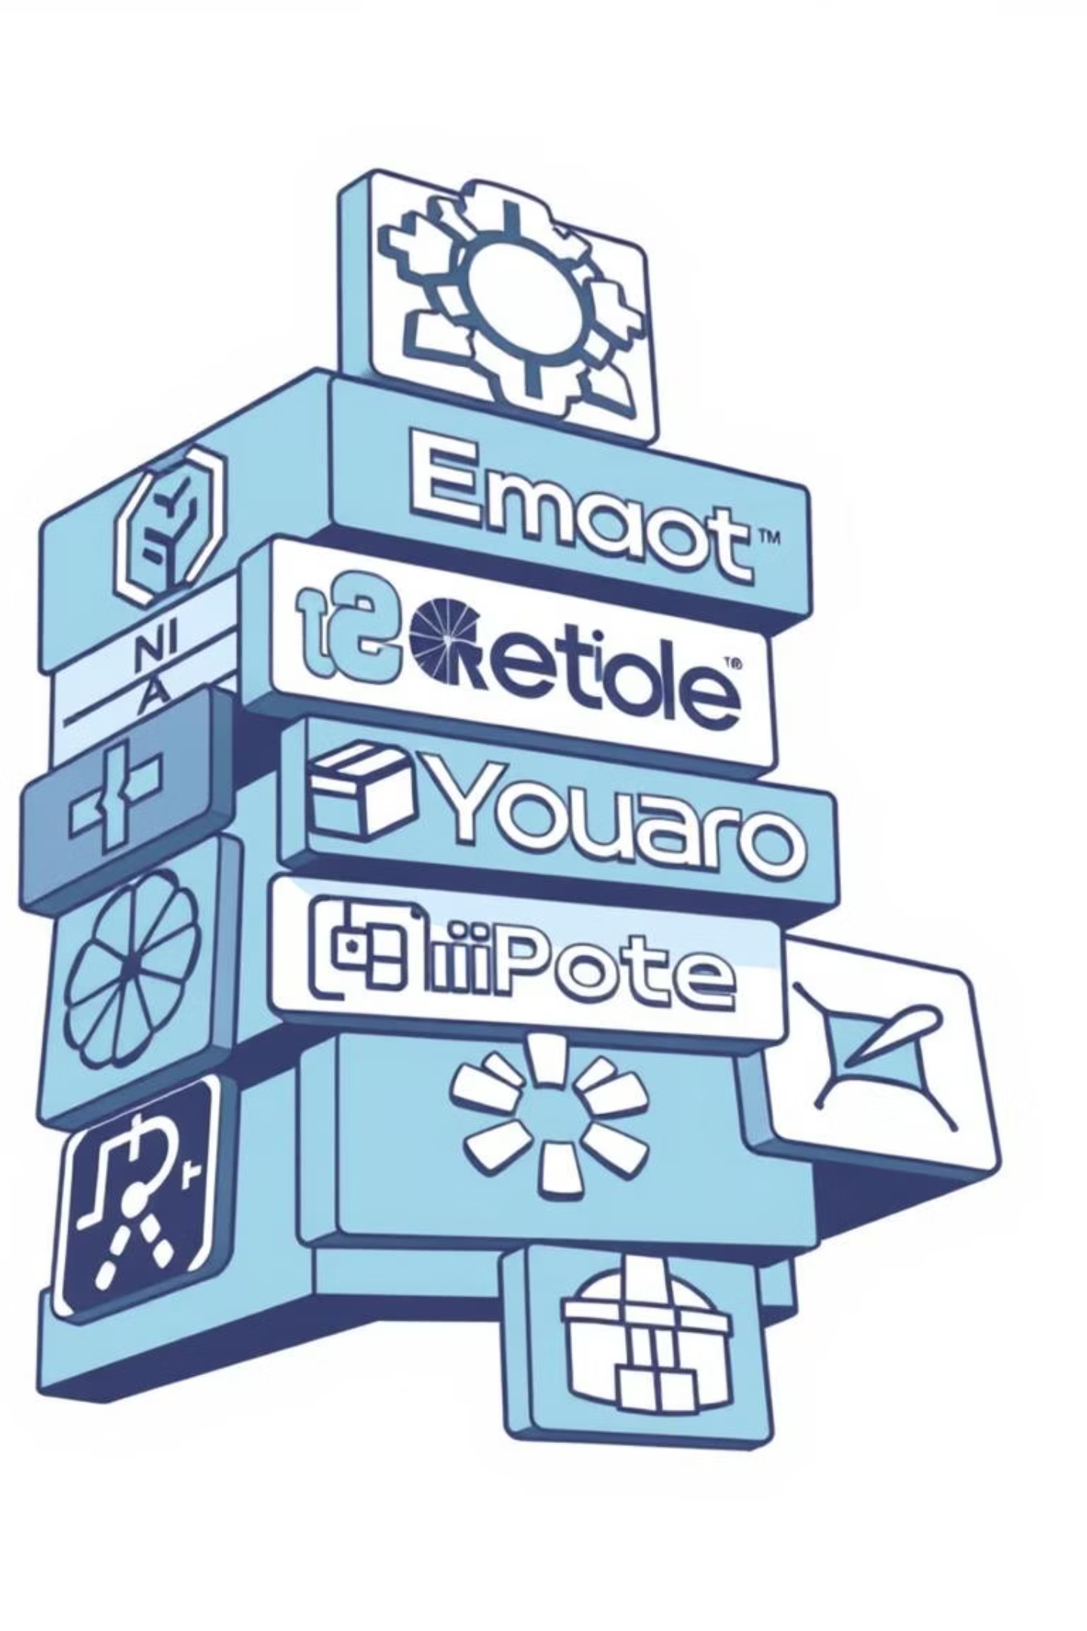

Technology Stack
Python 3
Programming Language
Pillow (PIL)
Image Processing Library
CLI
Command-Line Interface
Cross-Platform
Linux, Windows, macOS

Slide 6
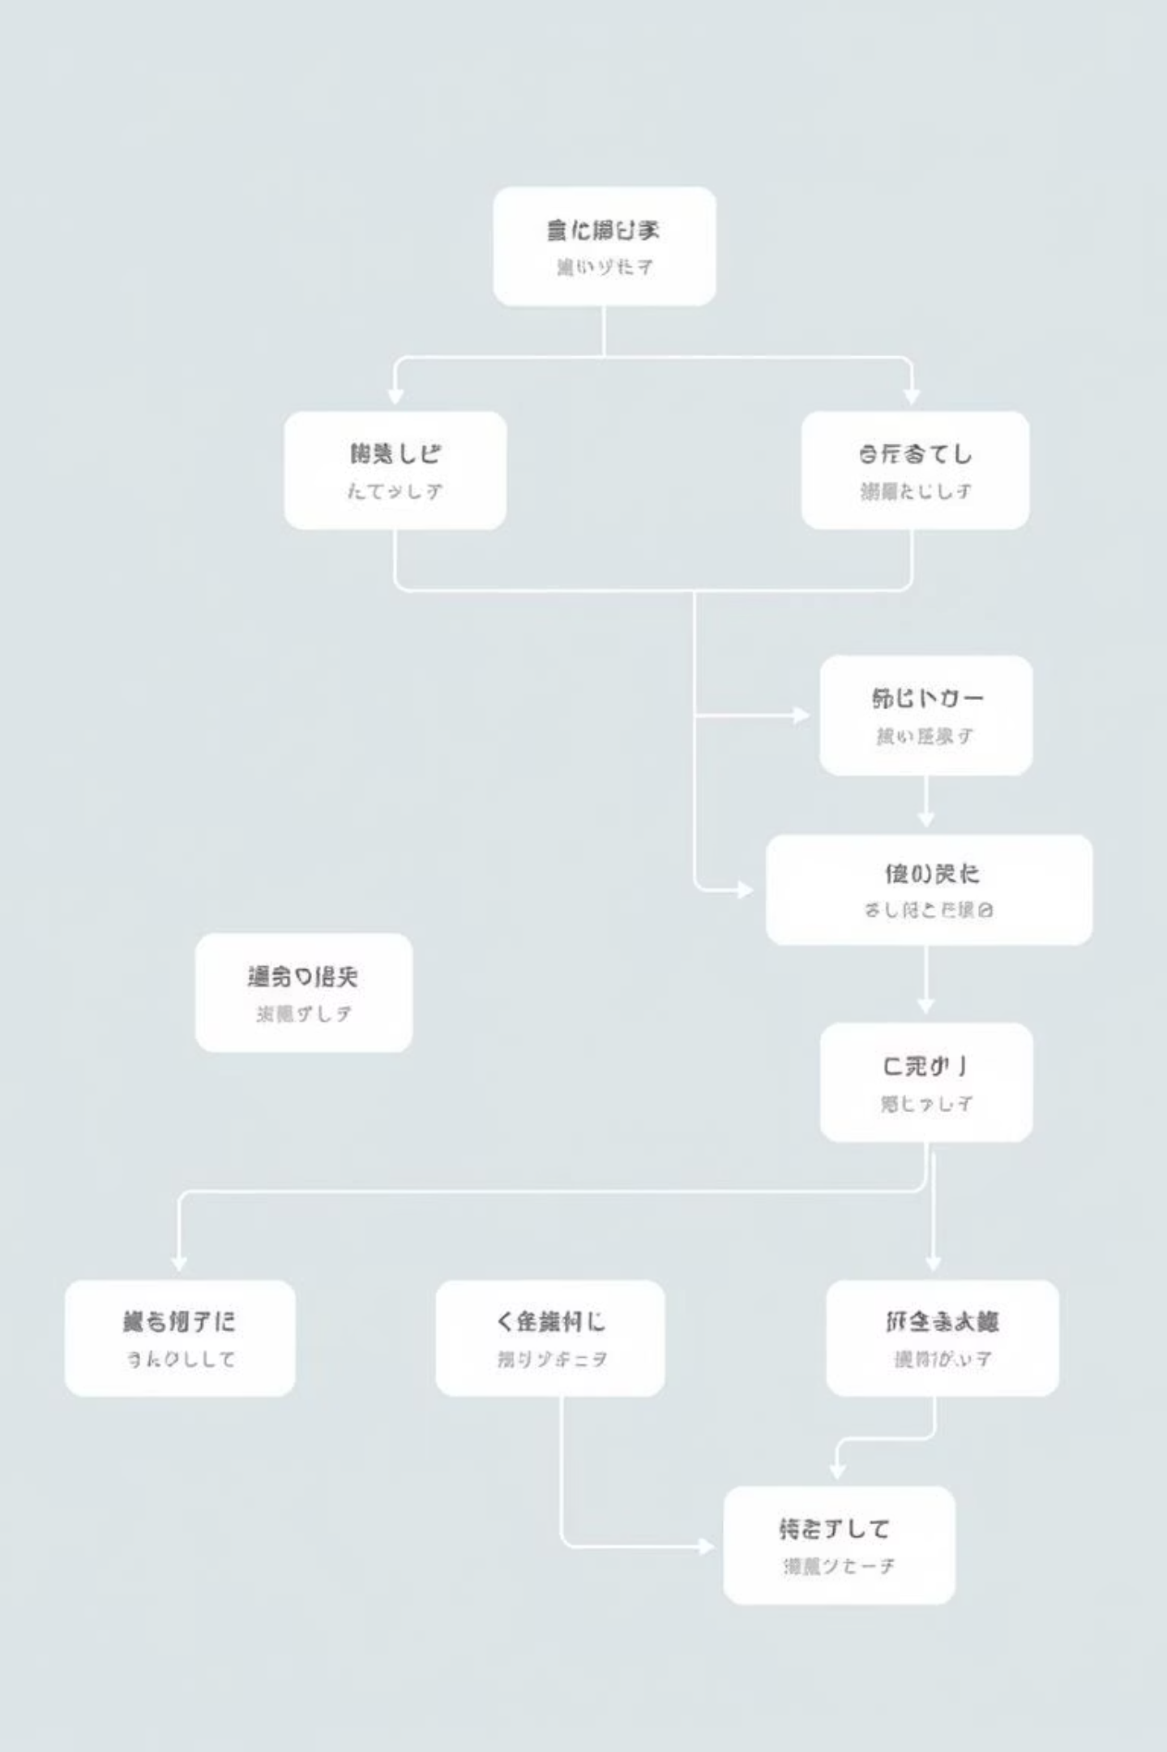



Tool Design Overview
The tool is a single Python script, image_cipher.py, supporting both encryption and decryption via CLI.
User Input
Operation type, image paths, numeric key.
Python Script
Handles all processing.
Processed Image
Encrypted or decrypted output.

Slide 7







Encryption Methodology
Encryption modifies each pixel's RGB values using a numeric key, ensuring complete restoration with the same key.
Encryption Formula:
Decryption Formula:

Slide 8

Tool Functionality & Structure
Functionality
Project Structure
Loads images from user paths.
image_cipher.py (Main)
requirements.txt (Dependencies)
Encrypts/decrypts via pixel manipulation.
sample_images/ (Test images)
Saves processed images.
Performs basic validation.
README.md (Usage)
LICENSE (MIT License)

Slide 9
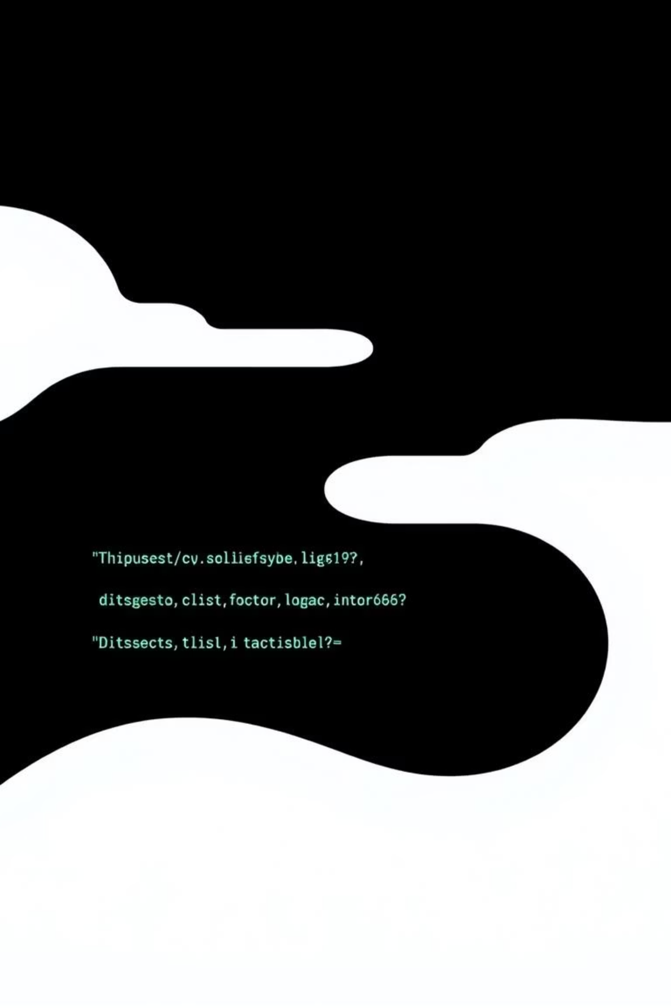
Execution & Error Handling
Execution Instructions
Error Handling
Verifies input image file existence.
Install dependencies:
Handles invalid menu selections.
pip install -r requirements.txt
Ensures numeric key input.
Run the tool:
python image_cipher.py
Follow on-screen prompts.

Slide 10

Limitations & Conclusion
Limitations
Conclusion
Not cryptographically secure.
This task successfully implemented a basic image encryption tool using pixel manipulation, fulfilling all requirements with professional structure and clarity.
Vulnerable to brute-force/statistical analysis.
Intended for learning and evaluation only.
Released under the MIT License.

